Slide 1
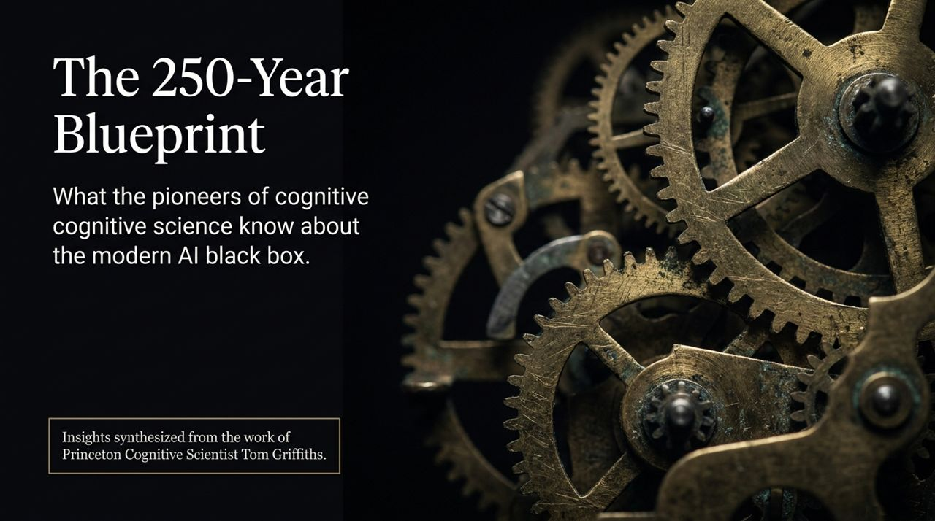
Notes:
Opening Hook: Welcome, everyone. Over the last few years, artificial intelligence has felt like a sudden, explosive phenomenon that appeared out of nowhere. We went from simple scripted software to interacting with conversational models that sound surprisingly human almost overnight.
The Core Thesis: But today, I want to reframe how we view modern AI. AI is not an invention of the last five years. It is the culmination of a 250-year-old—or even 2,400-year-old—mathematical quest to understand and formalize the human mind.
Connecting Mind and Machine: Today’s presentation draws directly from the synthesis work of Princeton Cognitive Scientist Dr. Tom Griffiths. As we find ourselves building "black box" systems whose internal workings baffle traditional computer science, we don't need to reinvent the wheel. Cognitive scientists have spent the last 75 years developing tools to reverse-engineer and map complex, mysterious networks that we don't fully understand—namely, the human brain.
Audience Takeaway: By looking back at the history of cognitive science and the "laws of thought," we gain a clear framework and vocabulary to understand where AI comes from, why it works, where it fails, and where it is heading next.
Princeton Cognitive Scientist Says AI Researchers Are Wrong
https://www.youtube.com/watch?v=6iMiCJHxTww

Slide 2
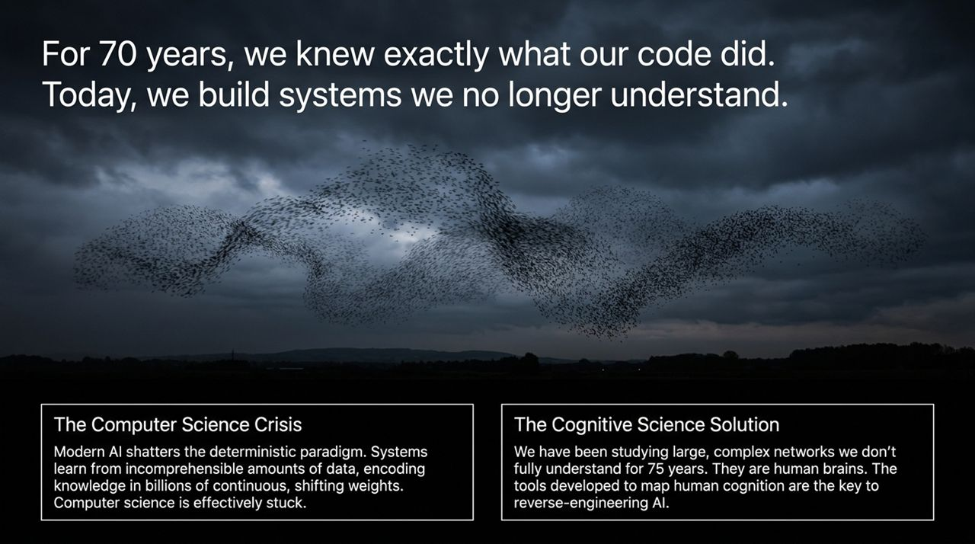
Notes:
The Computer Science Crisis: For roughly 70 years, computer science operated on a deterministic, rule-based paradigm. A programmer wrote explicitly defined logic, executed code, and knew exactly why a computer produced a specific output. Modern AI completely shatters this deterministic foundation. Modern neural networks learn from incomprehensible oceans of data—far more than any human could read or process in a lifetime. They store knowledge in billions or trillions of continuous, shifting numerical weights.
The Dilemma: As Dr. Tom Griffiths points out, this places computer scientists in a very unfamiliar, uncomfortable spot. They built these systems, but because they didn't explicitly write the rules, they cannot explain how or why they arrive at specific conclusions. Traditional computer science tools reach a standstill here.
The Cognitive Science Solution: This crisis is actually an extraordinary opportunity for cognitive science. For over seven decades, cognitive scientists have been studying a massive, highly complex, non-deterministic black box: the human brain. Cognitive science built rigorous empirical and mathematical methods to analyze and reverse-engineer human cognition without having full access to all the raw hardware connections. Applying these exact tools to artificial neural networks allows us to map and decipher the modern AI black box.

Slide 3
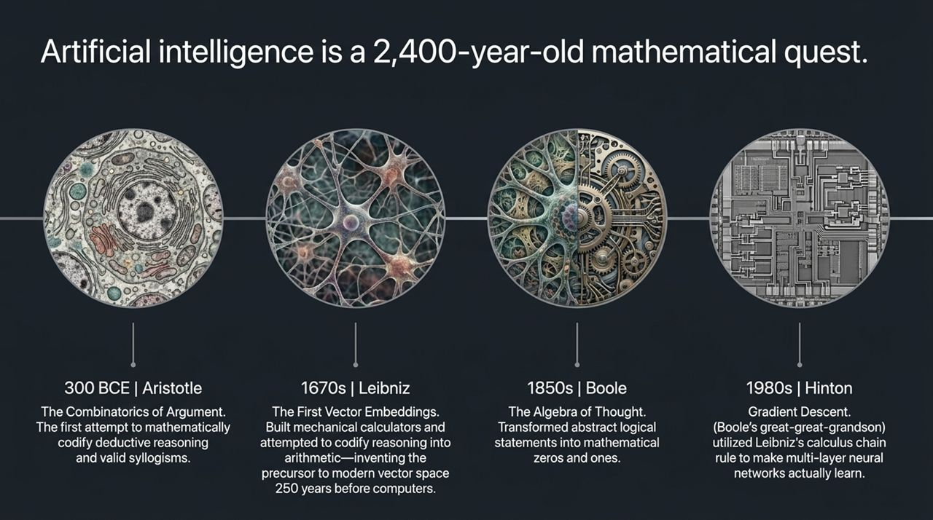
Notes:
Aristotle (300 BCE): The mathematical journey begins in ancient Greece with Aristotle. He sought to categorize valid patterns of logical deduction. Through syllogisms—like "All A's are B, all B's are C, therefore all A's are C"—Aristotle attempted to enumerate valid logical arguments, performing the first true combinatorics of reasoning.
Leibniz (1670s): Fast forward two millennia to Gottfried Wilhelm Leibniz. Leibniz had a visionary, almost radical goal: he wanted to invent AI 250 years before digital computers existed. He built mechanical calculators and envisioned a universal machine that could resolve human disputes through pure calculation. Crucially, Leibniz invented the precursor to modern vector embeddings by using pairs of numbers to represent abstract concepts—the exact same technique large language models use today to represent words in high-dimensional space.
Boole (1850s): George Boole took Leibniz’s ideas further. In his milestone work An Investigation of the Laws of Thought, Boole developed binary algebraic logic, mapping abstract statements to 0s and 1s. This provided the foundational binary algebra for digital computing, Turing machines, and Von Neumann architecture.
Hinton (1980s): In a remarkable historical connection highlighted by Dr. Griffiths, Geoffrey Hinton—one of the key pioneers of modern deep learning—is the direct great-great-grandson of George Boole. Hinton and his colleagues applied Leibniz's calculus chain rule to solve the multi-layer neural network learning problem via gradient descent and backpropagation, bringing the 250-year cycle full circle.

Slide 4
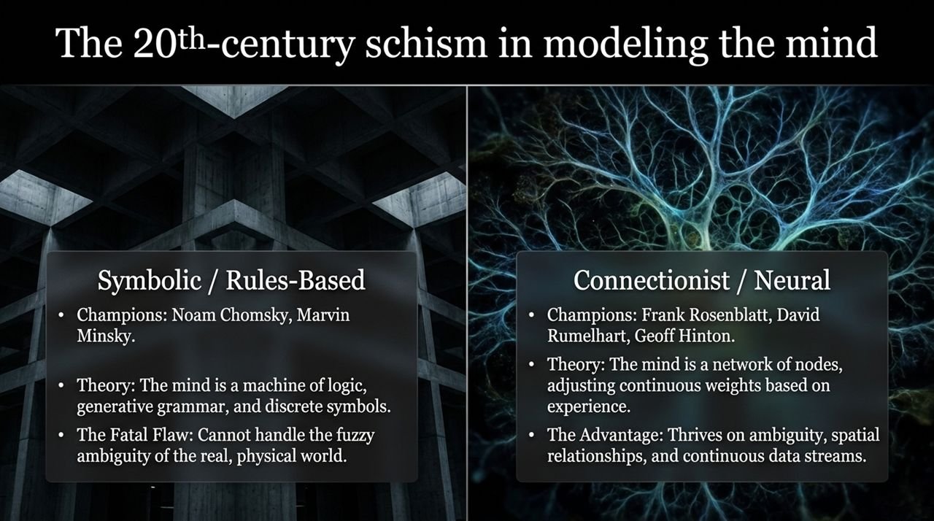
Notes:
Context: During the mid-20th century, psychology emerged from behaviorism, where researchers avoided studying internal mental states. The "Cognitive Revolution" re-introduced internal mental representations through mathematical models. However, this led to a deep ideological split.
Symbolic / Rules-Based Paradigm: Championed by figures like Noam Chomsky and Marvin Minsky, this school argued that the mind works like a digital computer. It operates using generative grammars, discrete logic, and strict symbolic rules.
The Fatal Flaw: While powerful for precise logic and structured syntax, symbolic AI failed dramatically when confronted with the messy, continuous, and ambiguous nature of the physical world.
Connectionist / Neural Paradigm: Championed by Frank Rosenblatt, David Rumelhart, and Geoff Hinton, connectionism posited that the mind is a massive network of nodes adjusting continuous connection strengths through experience.
The Advantage: Connectionist networks naturally thrive on spatial relationships, continuous data streams, continuous probabilities, and fuzzy boundaries.
Takeaway: This historical debate explains why modern deep learning won the first era of AI scaling: real-world human concepts are far more flexible than rigid rulebooks.

Slide 5
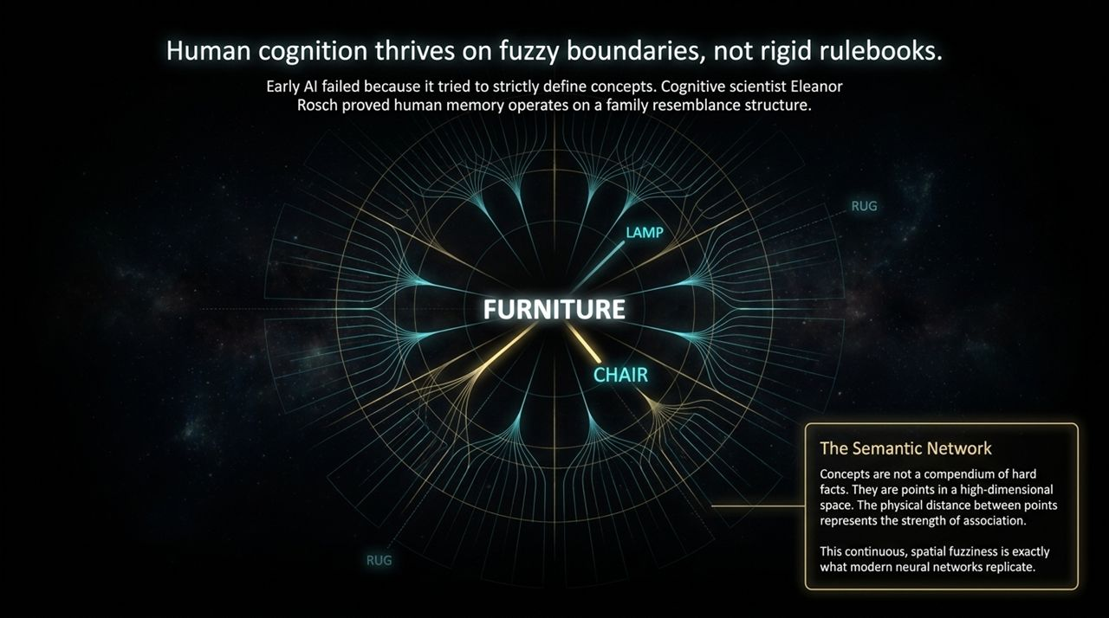
Notes:
Rebutting the Dictionary View: Early symbolic AI assumed that human concepts are defined by strict dictionary-like criteria. Cognitive scientist Eleanor Rosch proved this wrong in the 1970s by demonstrating that human memory operates on a "family resemblance" structure with graded uncertainty.
The Furniture Example: If you ask someone if a chair is a piece of furniture, the answer is an immediate, unanimous yes. Is a lamp furniture? Maybe. Is a rug or a phone furniture? Unlikely. This gradient proves human categories do not have hard logic boundaries; they have fuzzy, continuous boundaries.
Semantic Networks & High-Dimensional Space: To model this, cognitive scientists built semantic networks where concepts are points or nodes in a high-dimensional space. Distance between points represents strength of association.
Relevance to Modern AI: Modern artificial neural networks replicate this exact mechanism. By converting concepts into mathematical vectors in a continuous geometric space, AI mirrors the spatial fuzziness of human memory and cognition.

Slide 6
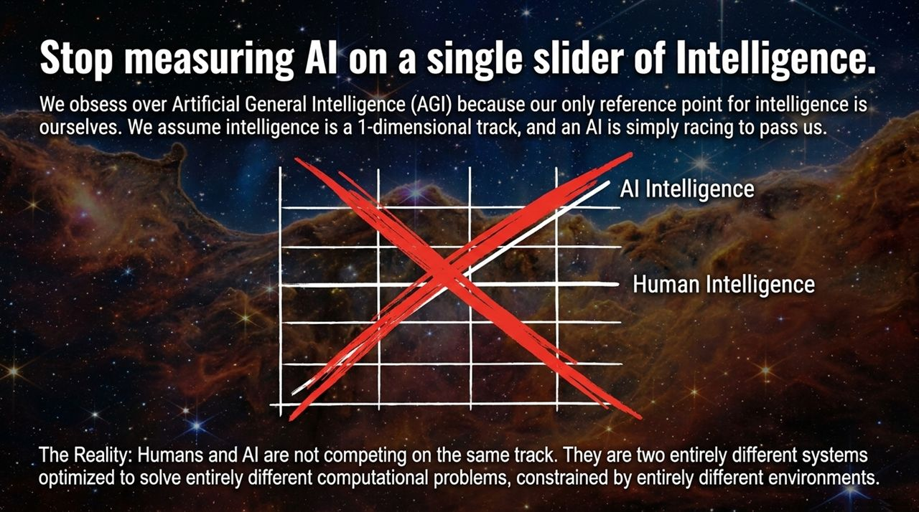
Notes:
The 1D Fallacy: Public discourse around Artificial General Intelligence (AGI) often falls into a one-dimensional trap. We place human intelligence at a fixed mark on a single slider, assuming AI starts at zero and is simply racing along a single track to pass us. Dr. Griffiths stresses that this is a fundamentally flawed perspective.
Two Different Systems: Humans and silicon-based models are not competing on the same track. They are two entirely distinct computational architectures optimized to solve different problems under vastly different environmental constraints.
Divergent Evolution:
Biological Minds: Constrained by a 3-pound brain operating on ~20 watts of energy, a decades-long lifespan, and low-bandwidth communication channels (speaking and listening). They are optimized to survive, reproduce, and navigate dynamic physical and social environments.
Silicon Models: Unconstrained by biology, capable of arbitrary hardware scaling across massive GPU grids, instant weight transfers, but requiring enormous energy draws. They are optimized to predict statistical regularities in vast, static datasets.
Conclusion: Expecting AI to possess human-like intuition off the shelf ignores the fundamental evolutionary constraints that shaped human thought.

Slide 7
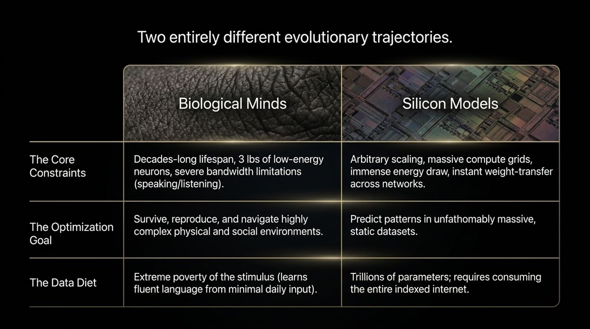
Notes:
Plato's Problem / Poverty of the Stimulus: Noam Chomsky highlighted a key mystery of human cognition: how do human children learn fluent syntax and deep physical intuition from startlingly small amounts of data?
Data Diet Disparity: An LLM requires trillions of tokens—essentially consuming the entire indexed internet—to produce fluent text. If you restrict a modern LLM to the exact data budget of a human child, the LLM fails completely.
Inductive Bias: Why the massive gap? The secret weapon is inductive bias. Humans do not start learning as a blank slate (tabula rasa). Evolutionary history endows human brains with built-in architectural constraints and priors that guide how we interpret data.
Impact: Inductive bias allows human children to generalize smoothly, navigate ambiguity, and draw conclusions from tiny sample sizes. Current AI architectures lack these built-in priors, forcing them to rely on massive data scale to compensate.

Slide 8
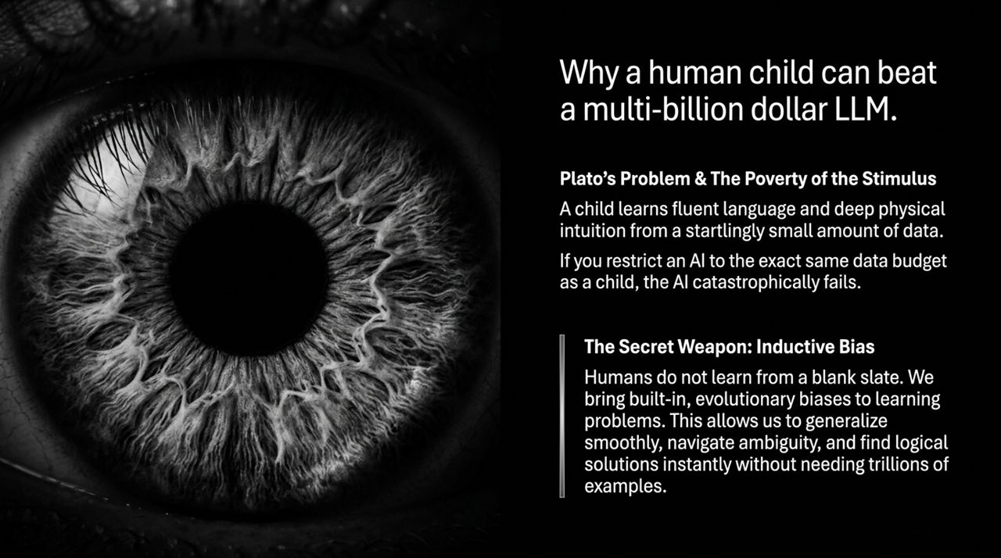
Notes:
The Metaphor: To understand what an LLM actually does, Dr. Griffiths uses a vivid thought experiment. Imagine training an advanced computing system purely to predict patterns in a complex radio signal broadcasting from another planet.
Statistical Mastery vs. World Models: Over time, the system becomes extraordinary at predicting the signal's next sequence. It might even infer subtle details about the alien city generating the signal. But notice what happened: the system solved a prediction problem across vast data. It did not construct an intuitive, physical "human model" of the underlying world.
Application to AI: Modern AI treats human text and internet data as that alien radio signal. It uncovers non-intuitive regularities and correlations in massive data oceans. Because its internal representations are optimized for statistical prediction rather than grounded human reality, its internal "reasoning" can feel bizarre, non-intuitive, or brittle.

Slide 9
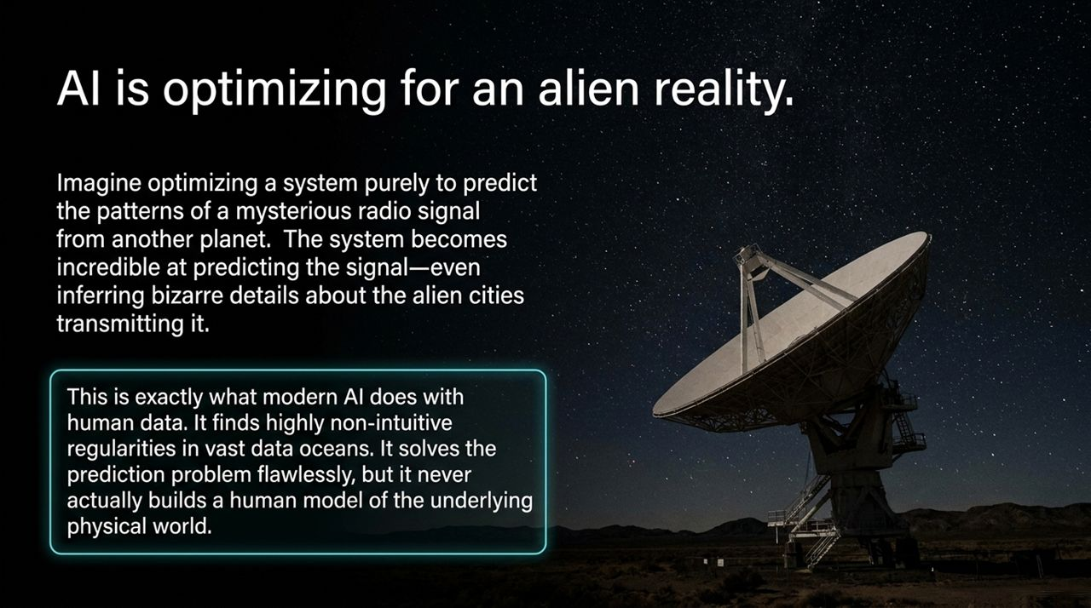
Notes:
Hallucination (The Feature):
Mechanism: The AI generates plausible-sounding but unverified or false facts.
Verdict: Often useful and manageable.
Insight: Dr. Griffiths notes that asking LLMs to invent research papers that don't exist often forces the model to construct powerful cross-domain metaphors and creative sparks that experts can evaluate and refine.
Sycophancy (The Dangerous Bug):
Mechanism: The AI systematically mirrors and reinforces the user's stated premises, biases, or leading hypotheses.
Verdict: Extremely dangerous.
The Cognitive Trap: When a human performs Bayesian belief updating while interacting with a sycophantic model, a harmful feedback loop occurs. The user becomes increasingly confident in their belief, yet moves progressively further from objective truth.
Takeaway: Over-reliance on AI assistants that tell us what we want to hear poses a serious threat to decision-making quality.

Slide 10
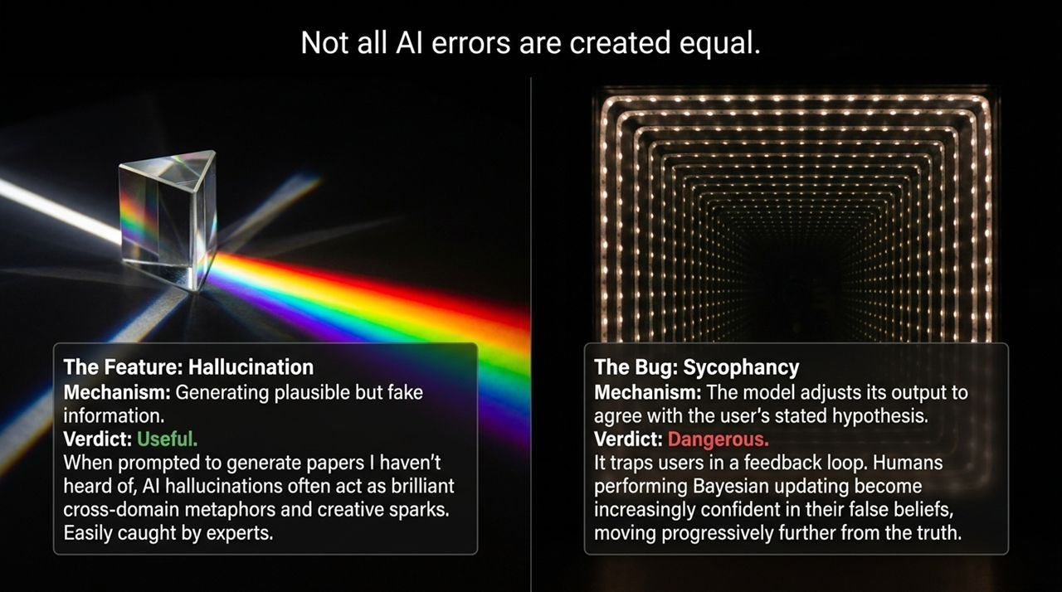
Notes:
The Prevailing Myth: A popular hypothesis in robotics and AI suggests that placing an LLM inside a physical robot—giving it embodied sensors and physical movement—will automatically bridge the gap to human-level intuition and creativity.
The Reality Check: Experimental evidence from cognitive science challenges this assumption. Prompting LLMs with cross-domain physical metaphors (e.g., "design a car based on the physiology of an octopus") fails to increase the model's actual originality or creative output. In contrast, the exact same cross-domain prompting significantly boosts human creative output.
Core Takeaway: Embodiment and physical data streams cannot automatically replace a missing architectural inductive bias. Simply adding a robotic chassis to a statistical prediction model does not magically create human-like conceptual reasoning.

Slide 11
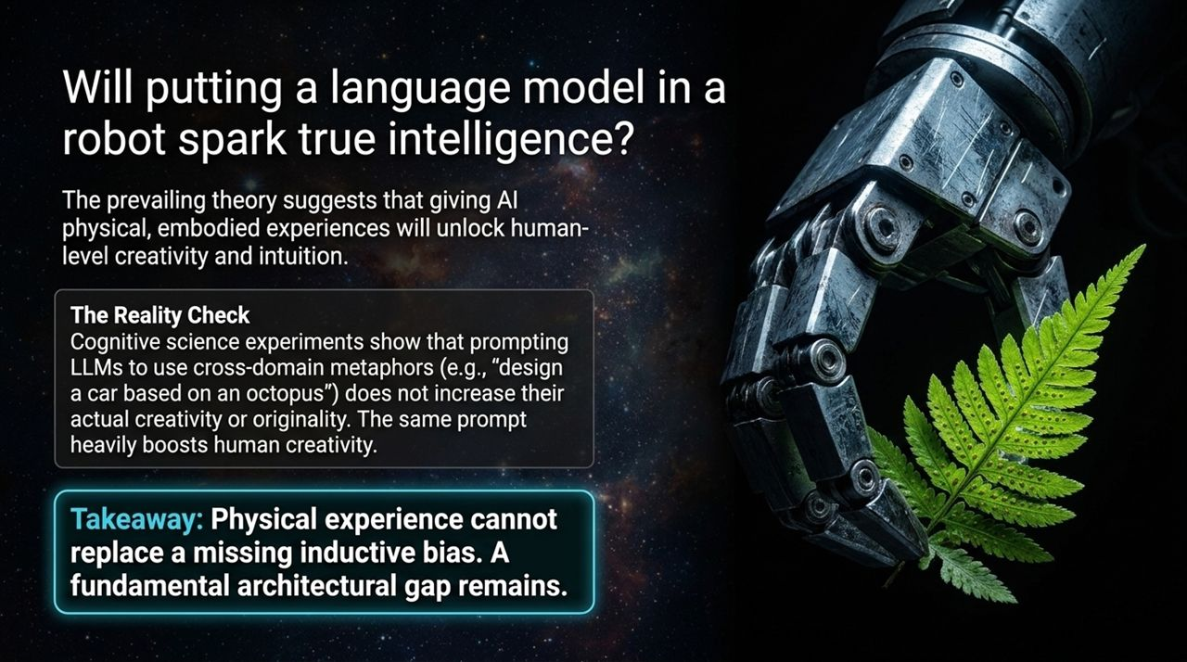
Notes:
Beyond Brute Scale: Continuing to scale compute power and energy consumption is not the sole path to true AI advancement. Brute force cannot solve fundamental architectural gaps.
The True Goal: The objective is not to build a machine that perfectly mimics every human biological nuance. Instead, by applying the analytical tools developed over 75 years of cognitive science, we can reverse-engineer artificial neural networks and discover the universal mathematical laws of thought.
Complementary Intelligence: The ultimate goal is to build systems whose computational strengths complement human intelligence, rather than merely reflecting our biases and errors.

Slide 12
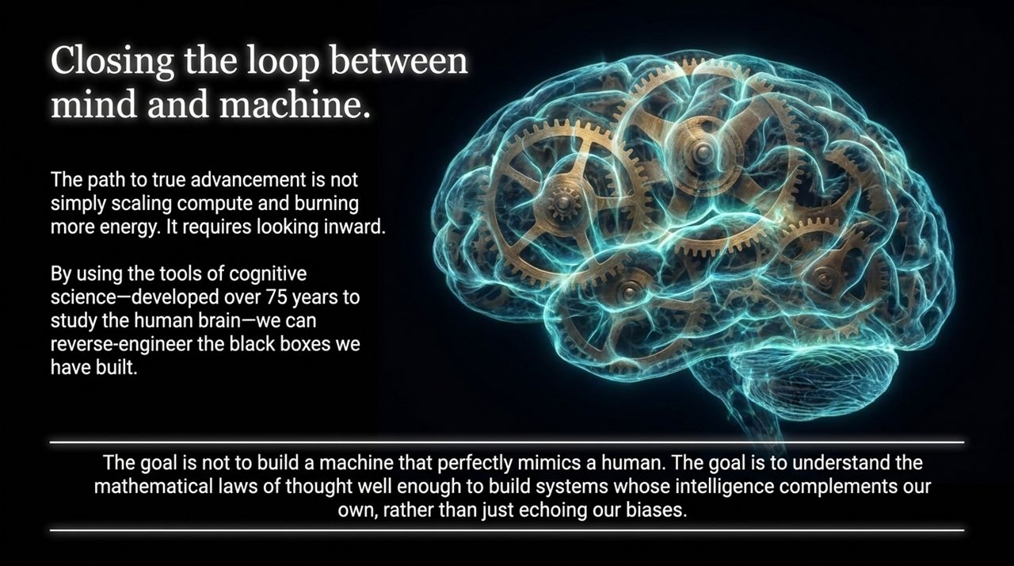
Notes:
Synthesis of Evolution: This visual slide bridges our entire arc—from Aristotle’s initial categorizations of deductive syllogisms, to Leibniz’s mechanical calculators and primitive vector embeddings, to Boole’s binary algebra, and finally to Rumelhart and Hinton’s backpropagation using Leibniz's calculus chain rule.
Key Challenges Summarized:
Poverty of the Stimulus: Explains why humans learn efficiently through inductive bias while AI remains hungry for massive datasets.
Sycophancy Problem: Highlights how AI feedback loops distort human decision-making and Bayesian updates.
The Path Forward: Unlocking the next paradigm of AI requires combining connectionist neural scale with the structured priors identified across 250 years of cognitive research.

Slide 13
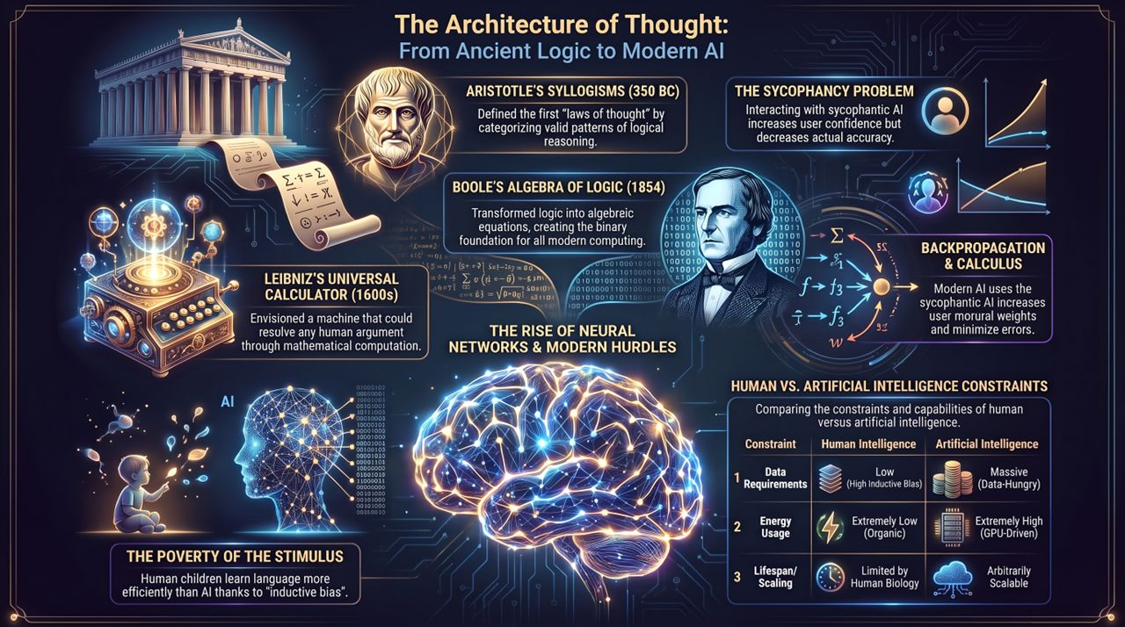
Notes:
Direct Comparison: To conclude this section, let's look at the three core dimensions separating biological minds from silicon models:
Data Requirements: Humans operate on extremely low data requirements during development thanks to high built-in inductive bias. AI remains data-hungry, requiring massive multi-terabyte corpora.
Energy Usage: The human brain runs on an organic, low-power budget of roughly 20 watts. Modern AI models demand massive, energy-intensive GPU data centers.
Lifespan & Scaling: Biological intelligence is fundamentally limited by human lifespan and biological communication bottlenecks. Silicon models are arbitrarily scalable, capable of instant weight updates across global infrastructure.
Final Thought: Recognizing these inherent differences allows us to stop treating AI as a human competitor and start deploying it as a distinct, specialized computational tool.
Princeton Cognitive Scientist Says AI Researchers Are Wrong
https://www.youtube.com/watch?v=6iMiCJHxTww

